Slide 1

Walmart Hurricane Analysis
Claire Curzan, Marlise Lucas, & Nate Bushey
Notes:
Hello everyone, and welcome to our presentation. Our names are Claire, Marlise, and Nate and will be walking through our midterm data analysis examining how Walmart store locations and customer purchasing behaviors responded during the approach of Hurricane Helene in Florida.

Slide 2
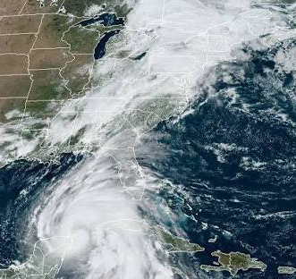
The Questions
Q1 - Demand Identification:
Which product categories experienced the greatest sales surge in the 7 days before hurricane landfall compared to the prior baseline period?
Q2 - SKU Consolidation:
After standardizing all Pop-Tart SKU variants into a single product, what is the true daily sales volume? How does the uncleaned (fragmented) view compare to the cleaned (consolidated) view? What business decisions would differ between the two views?
Q3 - Weather Correlation Analysis:
How do specific weather indicators (wind speed, precipitation, barometric pressure) correlate with daily sales volume across categories? Is there a detectable lag between weather severity escalation and purchasing spikes?
Notes:
To structure our project, we focused on five key questions. First, we identified which product categories experienced the greatest pre-storm sales surges. Second, we looked at SKU consolidation, specifically examining how fragmented Pop-Tart variants masked true customer demand. Third, we analyzed correlations between weather indicators like wind speed and barometric pressure, checking for any lag in purchasing behavior.

Slide 3
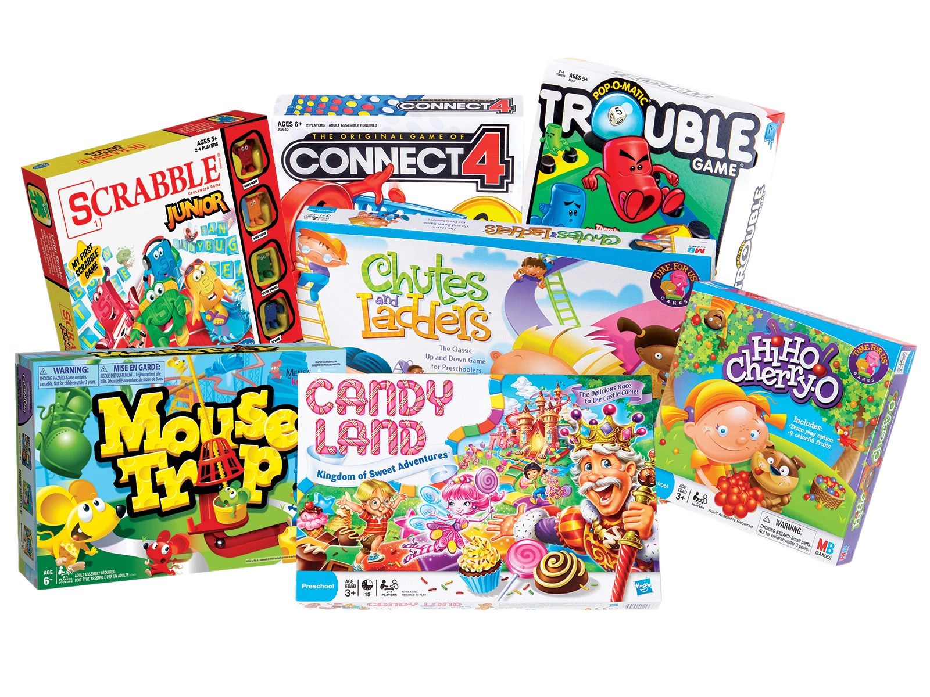
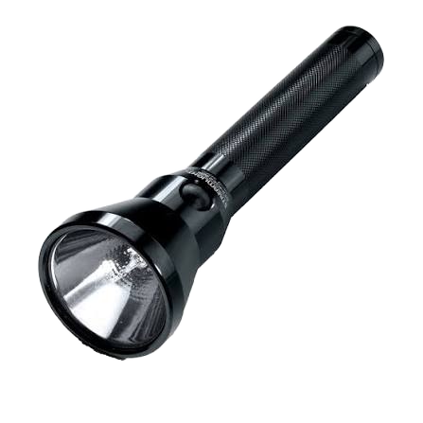

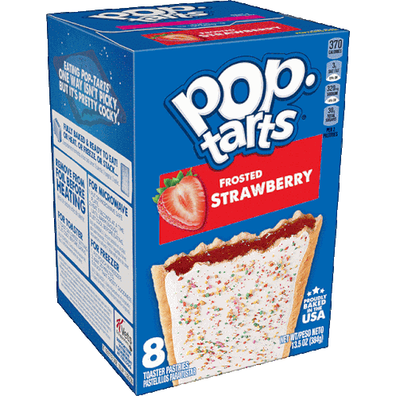
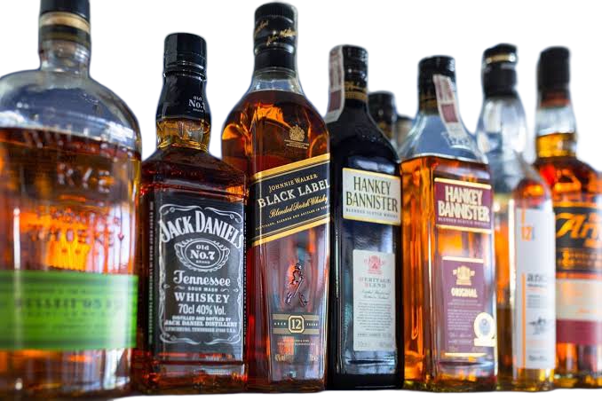
The Questions
Q4 - Store-Level Geographic Patterns:
Do all Florida store locations experience the same surge patterns, or do stores closer to the predicted hurricane path show earlier and larger spikes? Identify any stores that appear to be outliers.
Q5 - Signal vs. Artifact:
Was the extreme sales spike for the board games/entertainment category a genuine demand signal or a data artifact?
Notes:
Our final two research questions explored store-level geographic patterns across Florida, testing whether stores closest to the eye of the storm saw earlier or larger spikes, and evaluated whether a massive spike in entertainment and board game sales was a genuine demand signal or simply a data artifact.

Slide 4
Cleaning Breakdown
25,562 → 25,402 rows
130 negative quantities removed
881 rows with no usable date
45 SKUs → 20 products
Store IDs standardized
30 duplicate rows removed
Notes:
Just a quick breakdown of our cleaning stats, our data cleaning pipeline processed over 25,000 raw transaction rows. We removed 130 negative quantities treated as customer returns, dropped 881 rows with unusable timestamps, standardized our store IDs, and consolidated 45 messy SKUs down into 20 clean products

Slide 5
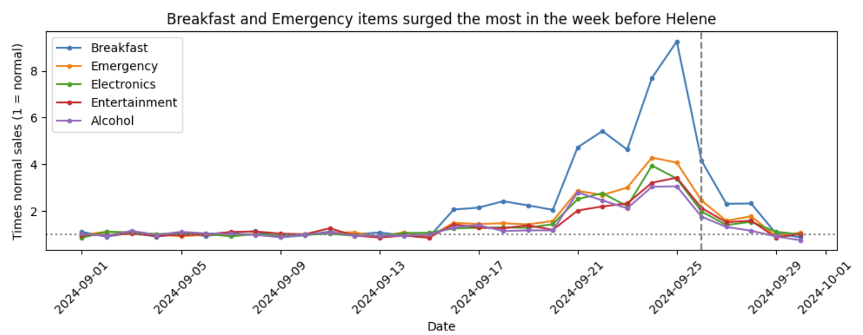
Q1 - Product Category Surge
Notes:
Looking at category demand over time, this line graph highlights how daily sales stayed relatively flat at baseline before spiking dramatically right before the storm on September 25th. Breakfast and emergency supplies experienced the sharpest escalation, surging well above normal baseline levels.

Slide 6
Q1 Answer: Sales Surge Highlights
Which product categories experienced the greatest sales surge in the 7 days before hurricane landfall compared to the prior baseline period?
01 • CATEGORY
Breakfast
+442%
02 • CATEGORY
Emergency
+199%
03 • CATEGORY
Electronics
+160%
04 • CATEGORY
Entertainment
+136%
05 • CATEGORY
Alcohol
+134%
PRE-LANDFALL DEMAND INSIGHTS (20TH–26TH)
Overall Demand Surge: Overall demand is expected to increase by 2.6 times baseline (2,816 units/day vs 1,103 units/day) .
Key Category Drivers: Led by essentials such as bottled water (3x) and shelf-stable breakfast foods like pop-tarts (5.4x peaking at 9.3x on the 25th).
Notes:
Breaking down the top categories in the 7 days prior to landfall, Breakfast led with a 442% increase, followed closely by Emergency goods at 199%, Electronics at 160%, Entertainment at 136%, and Alcohol at 134%. Overall store demand jumped to 2.6 times normal baseline volume, led heavily by essentials like bottled water and shelf-stable breakfast items

Slide 7
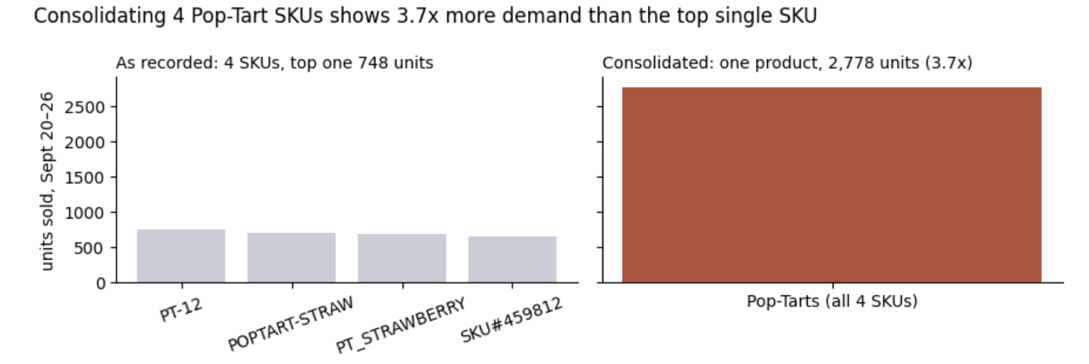
Q2 - SKU Consolidation
Pop-tarts across four distinct SKUs vs consolidated into one product.
Notes:
Moving on to SKU consolidation, we looked at how messy data can hide real product demand. When viewing Pop-Tarts as four separate, uncleaned SKUs, the top individual code only showed 748 units sold. However, once consolidated, the true total volume jumped to 2,778 units, roughly a 3.7x difference

Slide 8
Q2 Answer: True Sales Volume & SKU Consolidation
After standardizing all Pop-Tart SKU variants into a single product, what is the true daily sales volume? How does the uncleaned (fragmented) view compare to the cleaned (consolidated) view? What business decisions would differ between the two views?
UNCLEANED Data
Across 4 SKUs
107 / day
CONSOLIDATED Data
True Pre-Storm Volume
397 / day
PLANNING IMPACT
Inventory Deficit
3.7x Too Few
BUSINESS DECISION COMPARISON & IMPLICATIONS
Flawed Decision (Uncleaned): A planner relying on uncleaned data sees only ~107 units/day for the top SKU code, leading stores to order almost 4x too few units. As a result, inventory quickly exhausts right before severe weather arrives.
Optimal Decision (Cleaned): Combining all 4 SKU codes reveals true pre-storm demand jumping from 73 to 397 units/day (5.4x surge), establishing Pop-Tarts as the #1 product to stock before a storm.
Notes:
This consolidation has implications when looking at it from a business perspective. Relying on uncleaned data would lead inventory planners to stock nearly four times too few units, causing shelves to empty right when customers need them most. Consolidating the SKUs reveals the true pre-storm surge of 397 units per day, properly establishing Pop-Tarts as a top priority item to stock before a severe weather event, allowing for inventory planners to take action early.

Slide 9
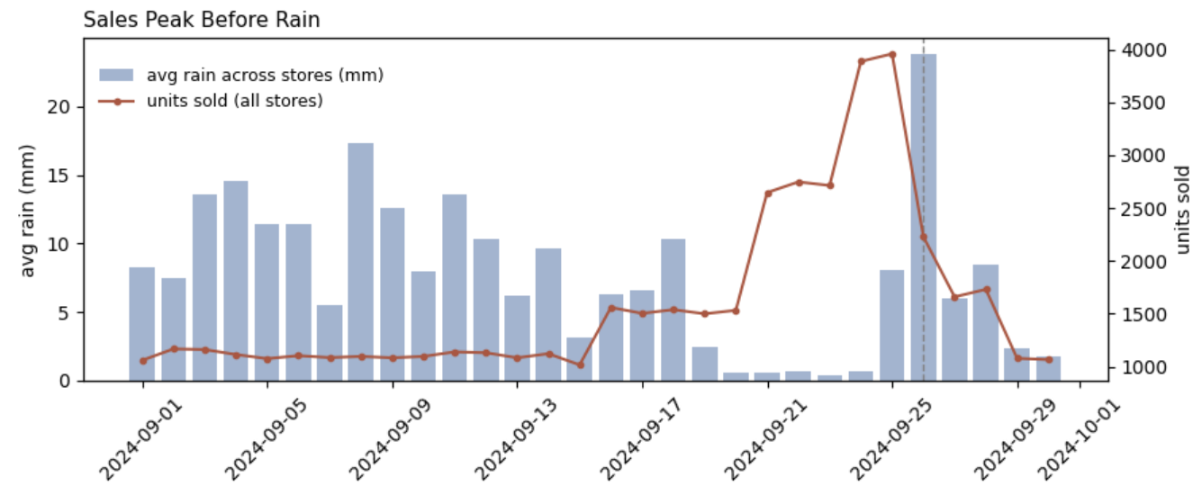
Q3 - Weather Correlation Analysis
Notes:
For weather correlation, we mapped daily order volume against weather metrics leading up to the storm. Interestingly, as this chart demonstrates, the massive sales peaks occurred right before heavy rainfall hit, indicating that people shop based on forecasts and weather escalation rather than waiting for the rain to start. The fear factor of storms based on weather forecasts can often lead to a surge in products even beyond what would be typical for similar weather events. In these kinds of situations the public typically over-prepares for fear of not having enough of the essentials.

Slide 10
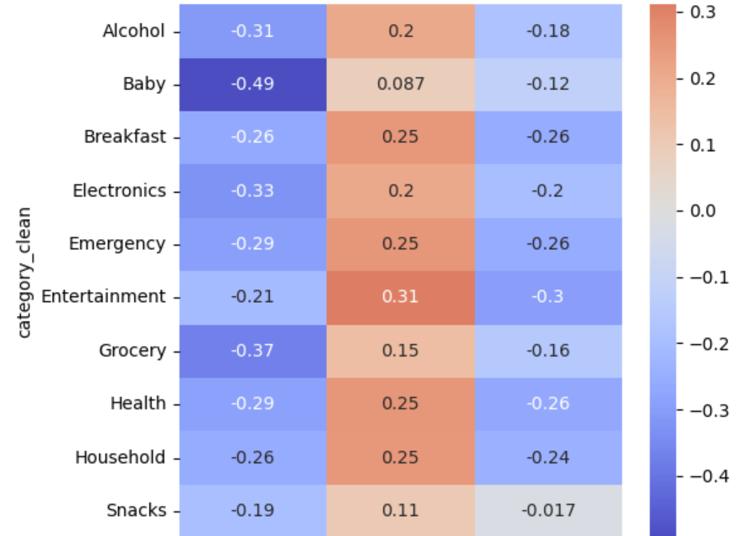
Q3 Heatmap- Weather vs. Sales Category Correlation
Takeaway 1
Wind Speed Drives Sales
Max wind speed shows a positive correlation (+0.09 to +0.31) with same-day sales in every category over the 30 days.
Takeaway 2
Pressure Moves Opposite Sales
Lower barometric pressure lines up with higher sales (-0.02 to -0.30). These same-day links are weak; the 2-day lag is much stronger (next slide).
Notes:
Our heatmap shows same-day correlations over 30 days. Wind speed is positively correlated with sales in every category (+0.09 to +0.31), and pressure is negatively correlated (−0.02 to −0.30). These same-day relationships are weak, which led us to test a lag.

Slide 11
Q3 Answer: Weather Correlation & Lag Analysis
How do specific weather indicators (wind speed, precipitation, barometric pressure) correlate with daily sales volume across categories? Is there a detectable lag between weather severity escalation and purchasing spikes?
Key Insight
Strongest Sales Match at 2-Day Lag
Shoppers stock up ~2 days before a storm hits based on forecasts. Sales correlate strongly with 2-day future wind speed (r = 0.79) and falling pressure (r = -0.80).
Lag Correlation Matrix (0 to 5 Days)
Day 0: rain r = -0.30 | wind r = 0.24 | pressure r = -0.24
Day 1: rain r = 0.01 | wind r = 0.60 | pressure r = -0.60
Day 2 (PEAK LAG):
rain r = 0.02 | wind r = 0.79 | pressure r = -0.80
Day 3: rain r = -0.06 | wind r = 0.60 | pressure r = -0.61
Day 4: rain r = -0.03 | wind r = 0.42 | pressure r = -0.43
Day 5: rain r = -0.10 | wind r = 0.34 | pressure r = -0.36
Behavioral Context
Same-Day Drop: Same-day rain has negative correlation (-0.30) because shopping stops once rain arrives.
Why Negative Pressure? Barometric pressure drops as a hurricane approaches. Thus, lower pressure 2 days later aligns with higher stocking sales today.
Notes:
When we tested lag intervals from 0 to 5 days, we found the strongest sales match at a 2-day lag. Shoppers stock up roughly two days before a storm hits, showing exceptionally strong correlation with future 2-day wind speed and falling barometric pressure. Meanwhile, same-day rain showed a negative correlation because actual rainfall halts trips to the store.

Slide 12
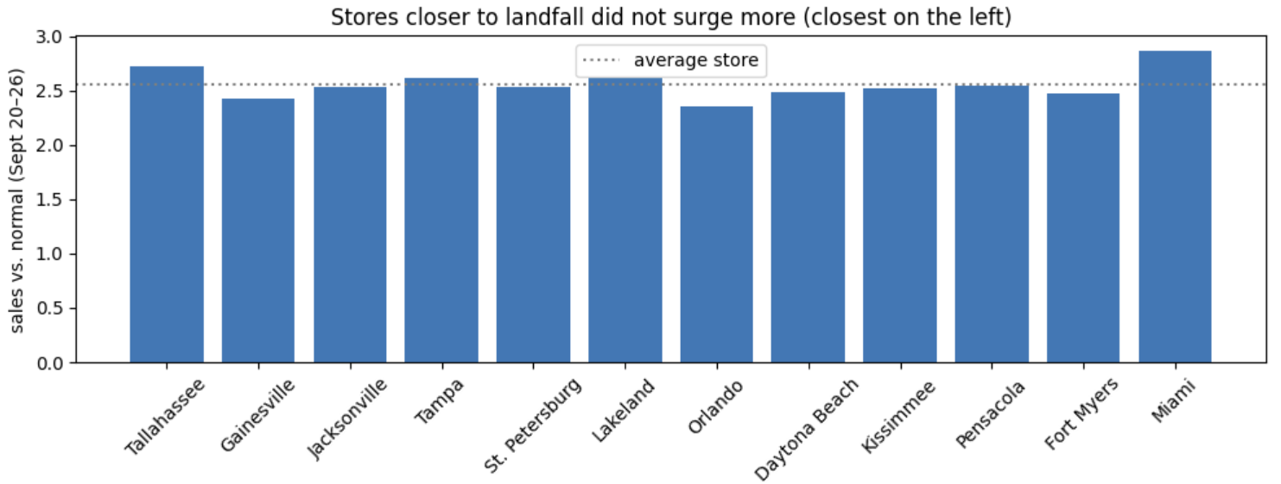
Q4 - Store-Level Geographic Patterns
Notes:
Next, we examined store-level geographic patterns across Florida, ordering stores from closest to farthest from the predicted landfall on the left. Surprisingly, stores closer to the eye of the storm did not show higher sales surges than those further away.

Slide 13
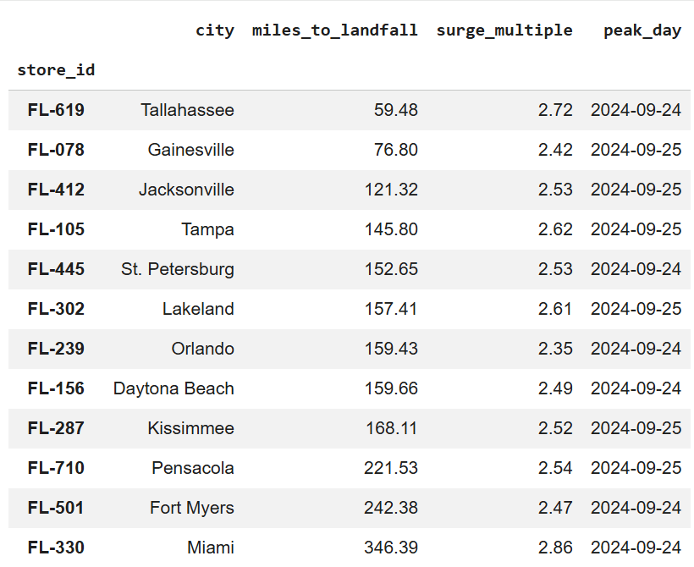
Q4 Chart and Breakdown
Distance & Surge Correlation
+0.38 (Weak positive, n = 12 stores))
Biggest Surge Location
FL-330 Miami
Surge Multiple: 2.86x (Farthest from landfall)
Smallest Surge Location
FL-239 Orlando
Surge Multiple: 2.35x
Notes:
Looking closer at the metrics, the distance to surge correlation was actually a weak positive correlation of +0.38, meaning farther stores surged slightly more. The largest surge occurred at our furthest location, Miami (FL-330), with a 2.86x multiple, while Orlando experienced the smallest surge at 2.35x

Slide 14
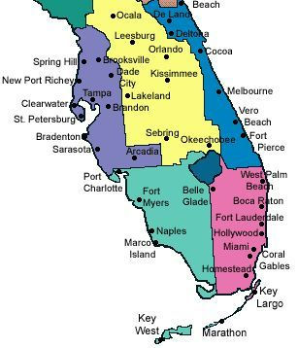
Q4 Answer: Geographic Surge Patterns
Do all Florida store locations experience the same surge patterns, or do stores closer to the predicted hurricane path show earlier and larger spikes? Identify any stores that appear to be outliers.
LANDFALL PROXIMITY VS. SURGE
+0.38 Correlation
Being closer to landfall didn’t mean a bigger surge. The correlation actually leans the other way.
BIGGEST SURGE
Miami
2.86x (farthest away)
SMALLEST SURGE
Orlando
2.35x (lowest spike)
SUMMARY FINDING
Store demand spikes were widespread across Florida rather than concentrated strictly near landfall coordinates, with Miami presenting the largest relative surge overall. Every store peaked on Sept 24 or 25, so stores near the path did not spike earlier.
Notes:
Ultimately, our geographic analysis proved that hurricane preparation demand was widespread across the entire state of Florida rather than tightly concentrated near the immediate landfall coordinates

Slide 15
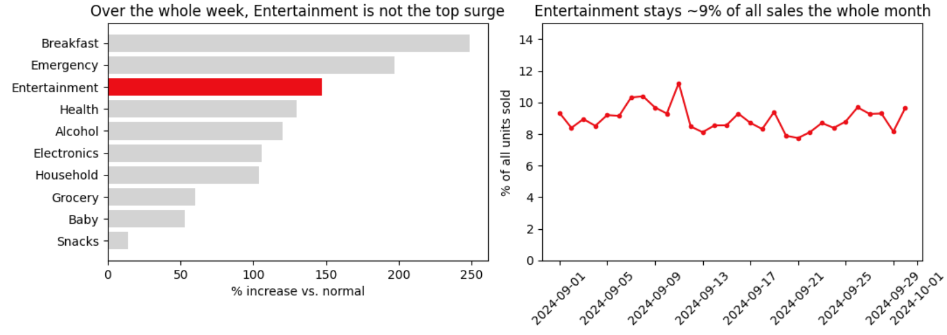
Q5 - Signal vs. Artifact
Notes:
For our fifth question, we investigated whether the extreme sales spike in the board games and entertainment category was a genuine demand signal or a data artifact. While entertainment spiked 272% on its single best day, its monthly share of sales remained remarkably constant

Slide 16
Q5 Answer: Signal vs. Data Artifact
Was the extreme sales spike for the board games/entertainment category a genuine demand signal or a data artifact?
PEAK VS. WEEKLY SURGE
+272%
Single best day peak
+147% over whole week
TOTAL SALES SHARE
9%
Constant sales ratio
Maintained ~9% of all sales in both normal and storm weeks due to higher overall traffic.
CATALOG ANOMALY
4 SKUs -> 2 Products
Uncataloged inventory → Category lumping
"Entertainment" mixes Monopoly and Playing Cards under 4 different spellings. Monopoly alone rose 2.78x vs 2.55x storewide.
SUMMARY VERDICT
Entertainment’s surge was driven by increased storewide customer volume (maintaining a constant 9% of sales). Recommendation: don't stock extra board games beyond the normal traffic increase; put extra inventory into Pop-Tarts and emergency supplies.
Notes:
Our verdict is that entertainment's surge was a data artifact driven entirely by increased storewide customer volume rather than a sudden craze for board games. Entertainment maintained a steady 9% ratio of all units sold throughout both normal and storm weeks, and the category lumps Monopoly in with playing cards. Our recommendation is not to stock extra board games, and to prioritize Pop-Tarts and emergency supplies instead.

Slide 17
Five Core Findings
5.4x
Pop-Tart surge vs. 2.6x for all products
45 -> 20
SKUs consolidated into real products
Sales Peaked
2 days before Landfall
9%
Entertainment stays constant throughout the month
2.86
Largest surge occurred in Miami (the furthest store)
Notes:
To wrap up, our five core findings show a 5.4x Pop-Tart surge, successful SKU consolidation down to 20 canonical products, a consistent 2-day pre-storm purchasing lag, steady entertainment sales ratios, and the surprising finding that Miami, our furthest store, saw the largest relative surge. Thank you for your time and we welcome any questions!

